Slide 1
Safety Day
Presented by:
Jennifer Meyer

Slide 2
Emergency Scenario
Fire started in the kitchen of 3rd floor Assisted Living. Full evacuation of the building to happen due to more than half of the 3rd floor burning with inability to control the fire.
Second Phase: Care Center to be fully evacuated due to fire engulfing the Villa and working its way to the Care Center with the smoke to thick to shelter in place.
Weather NOT in our favor:
Brush Fire by the water town is moving its way towards the Care Center. The smoke is very dense and its working its way into the Care Center HVAC system.
Notes:
Care Center: Follow the Shelter in Place procedure and look to your Person in Charge for directions: Move all residents/visitors/family members from Hearthstone and Springview across the way to the other two neighborhoods.
Villa: Follow the Shelter in Plan procedure and look to your Person in Charge for directions: Make sure all windows in apartments are closed and move the tenants to the hallways; place towels in front of the apartment doors to prevent the smoke from entering the apartments.

Slide 3
External Partners
Red Wing Police Department – Captain Tony Grosso
Red Wing Fire Department – Andy Speltz
Goodhue County Health and Human Services – Heather Ardnt
Deputy State Fire Marshal – Steven Jurrens

Slide 4
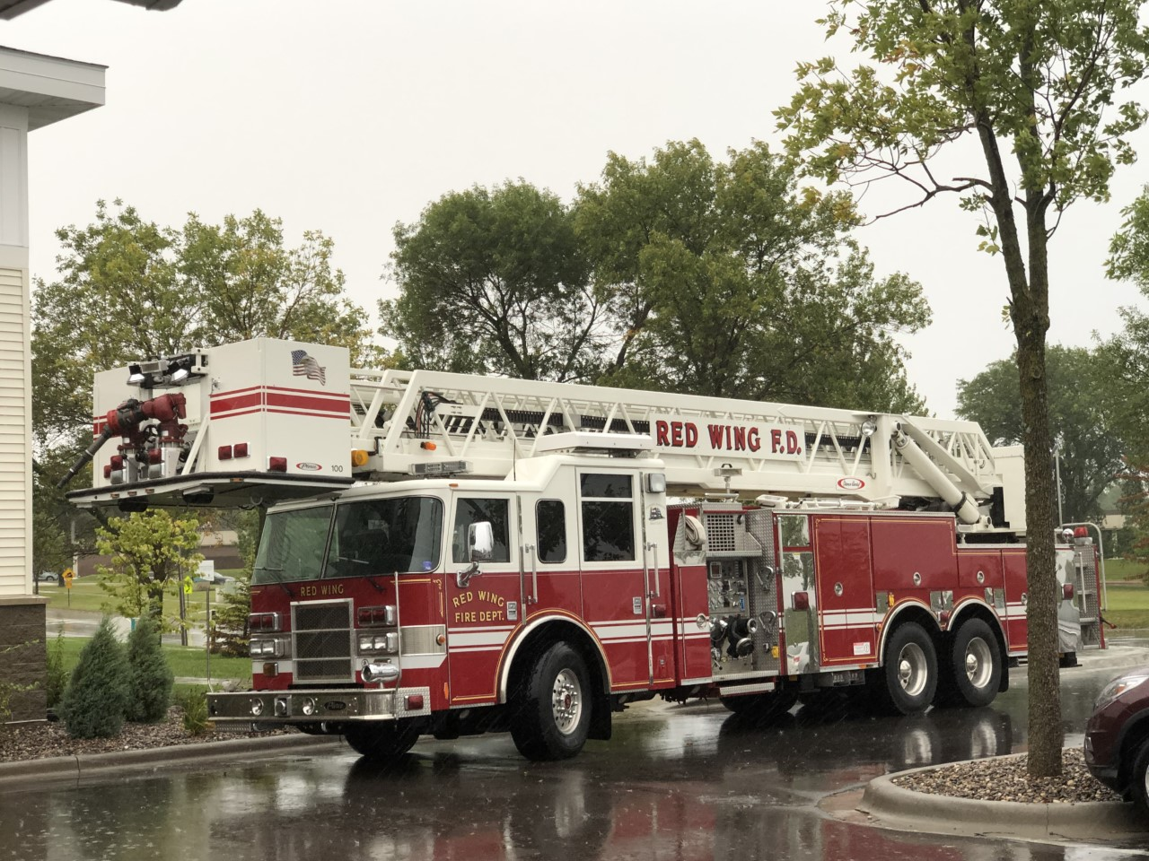

Slide 5
Internal Partners
ALL Employees of St. Crispin Living Community. (76 participated)
Residents of the Care Center
Tenants of the Assisted Living/Memory Care.
Family members in building at the time.
Any visitors in the building at the time.

Slide 6
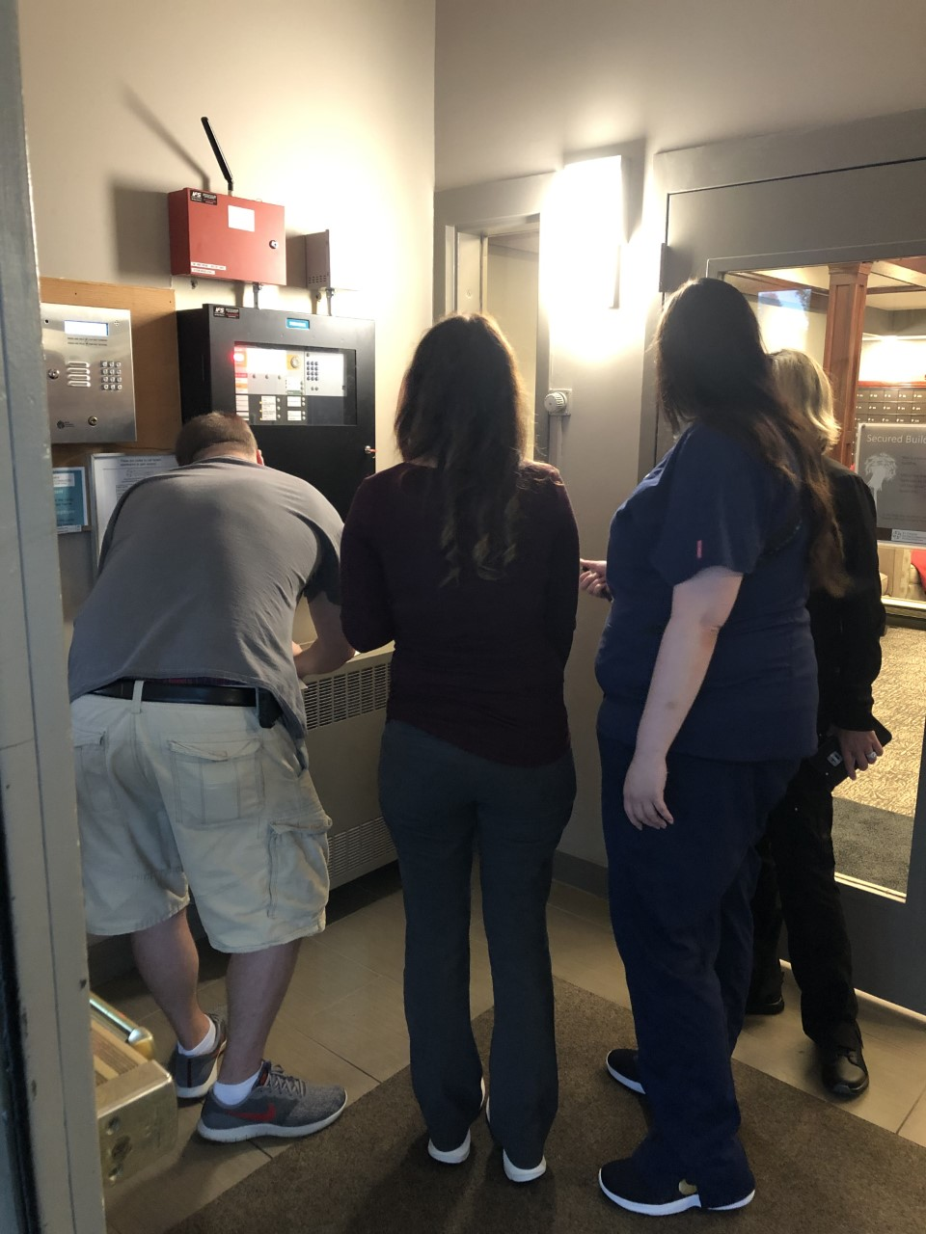
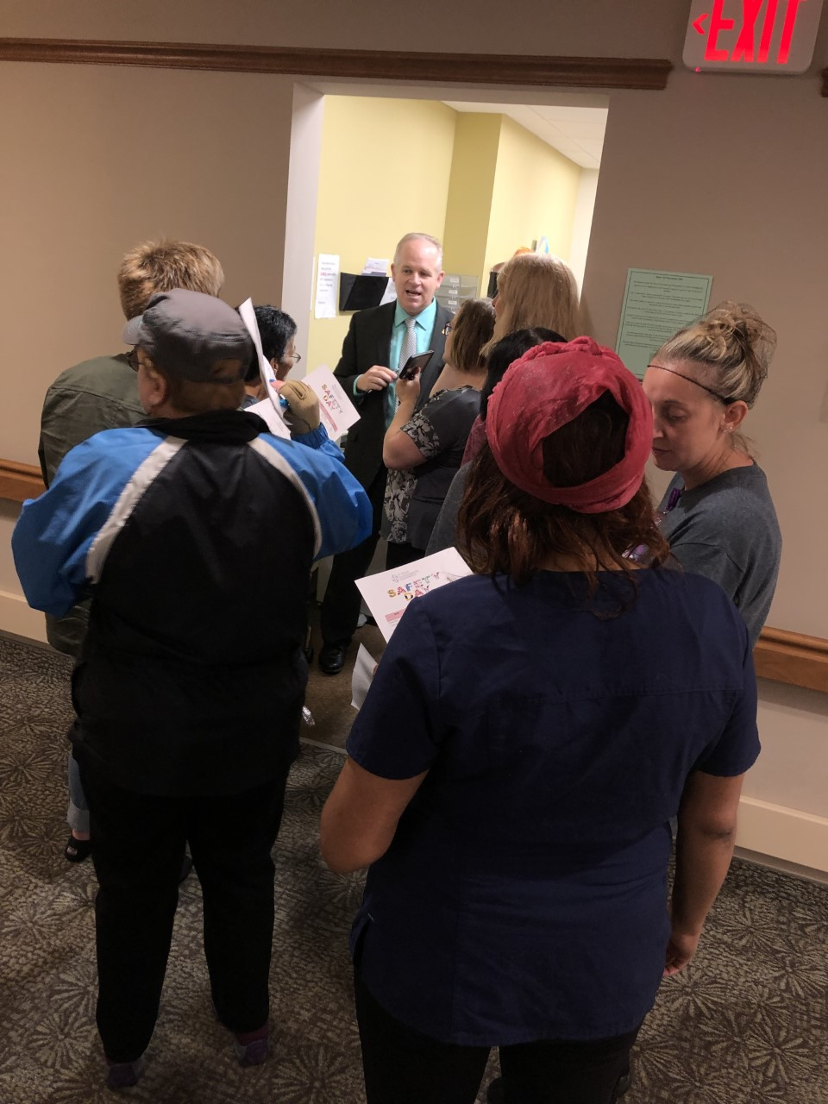
Fire Panels

Slide 7
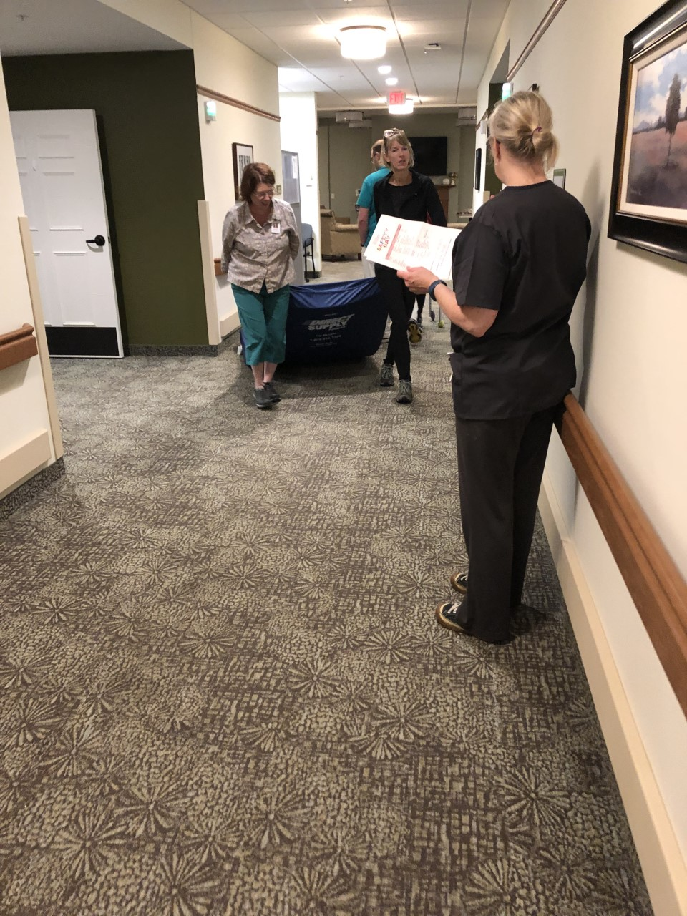
Mattress Drag

Slide 8
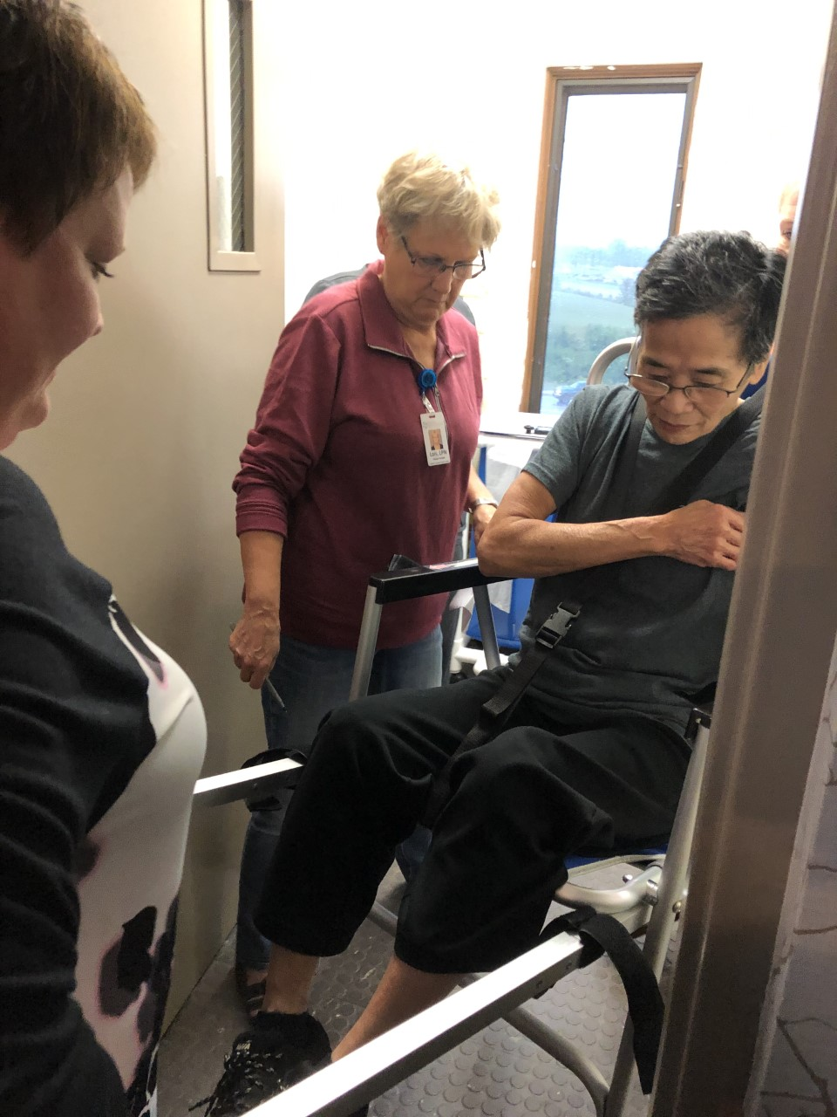
Stair Chair

Slide 9
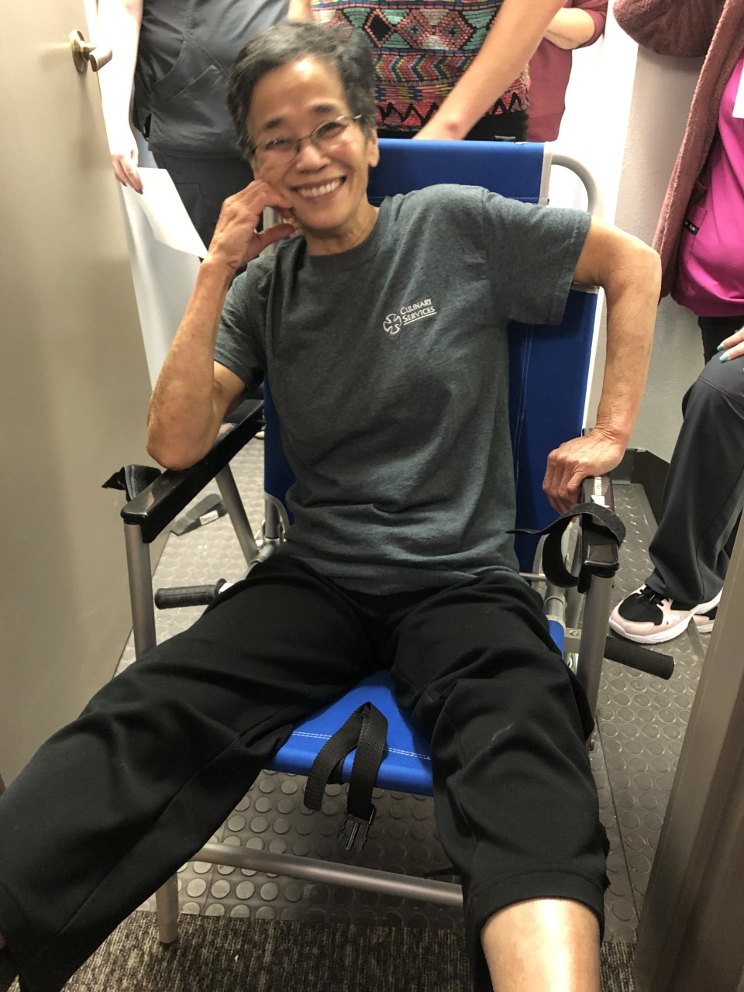
Stair Chair Fun

Slide 10
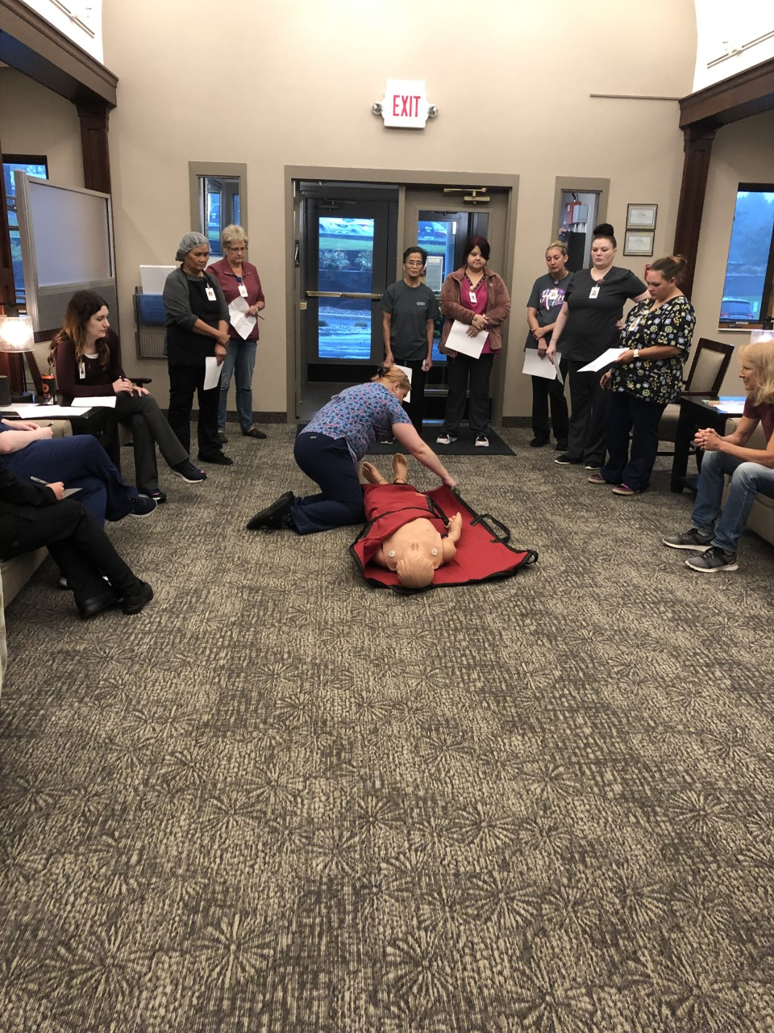
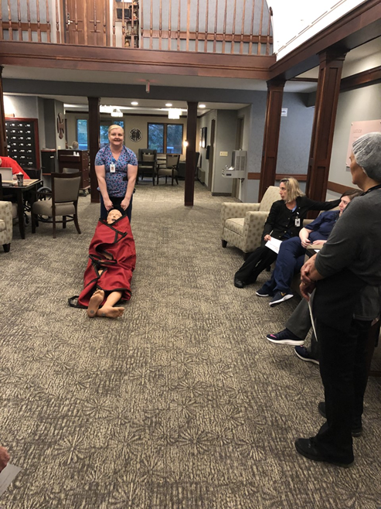
Blanket Drag

Slide 11
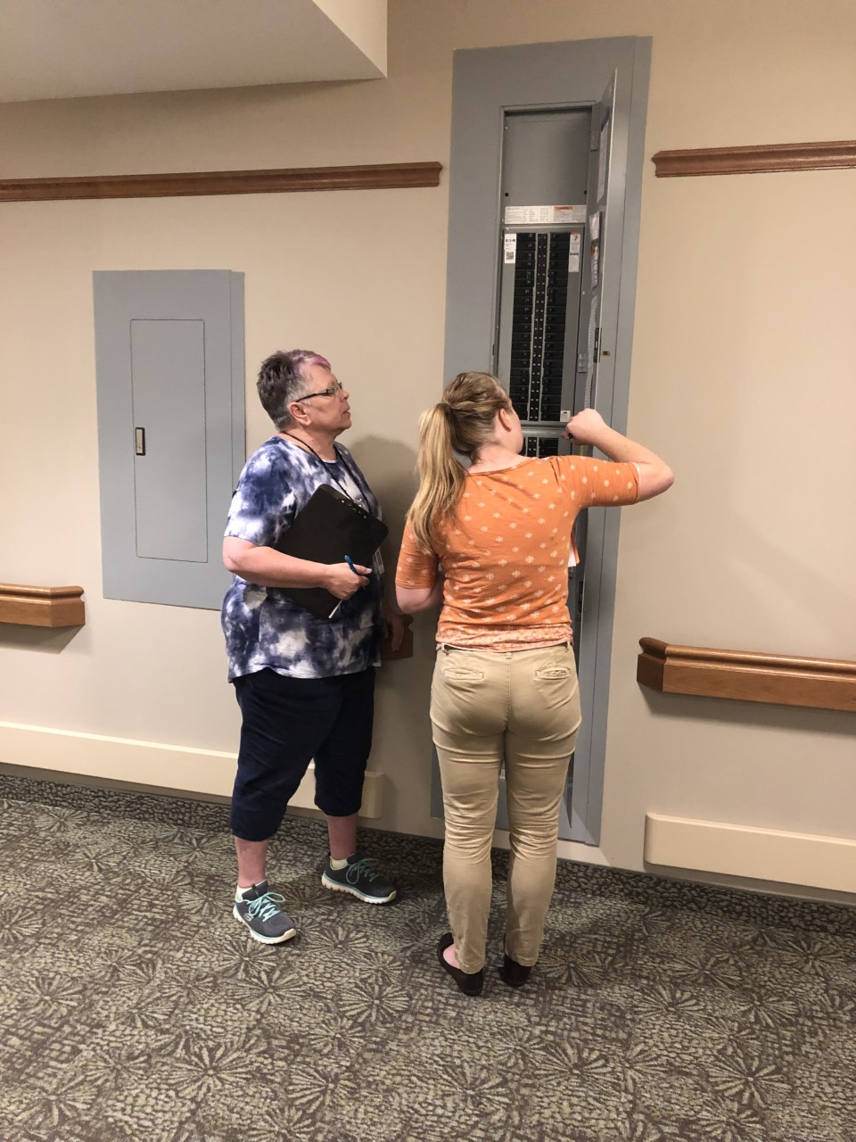
Circuit Breakers

Slide 12
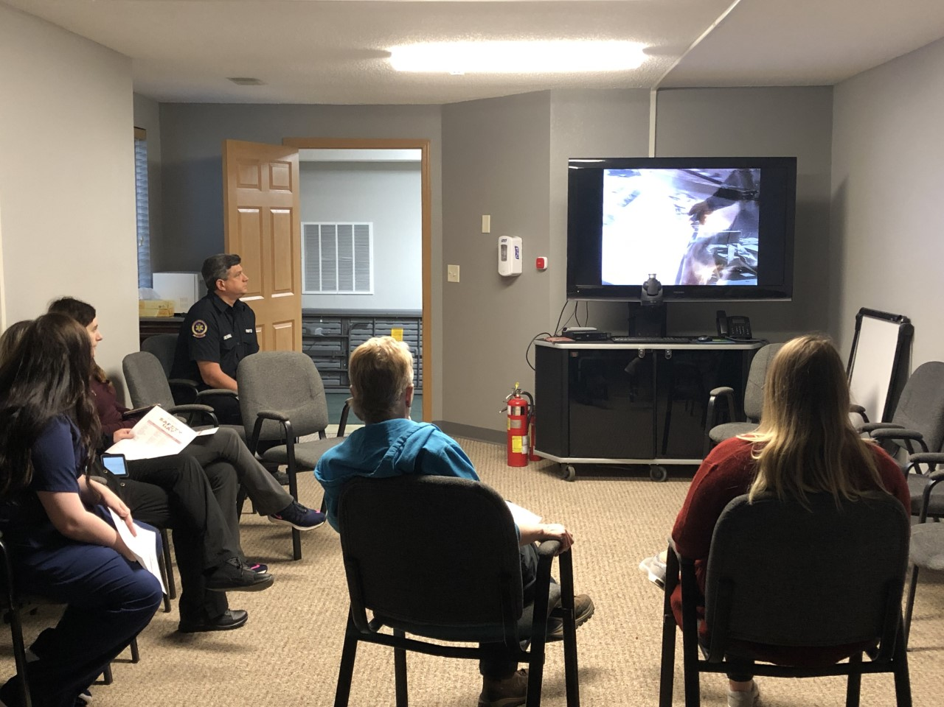
Fire Extinguisher Use

Slide 13
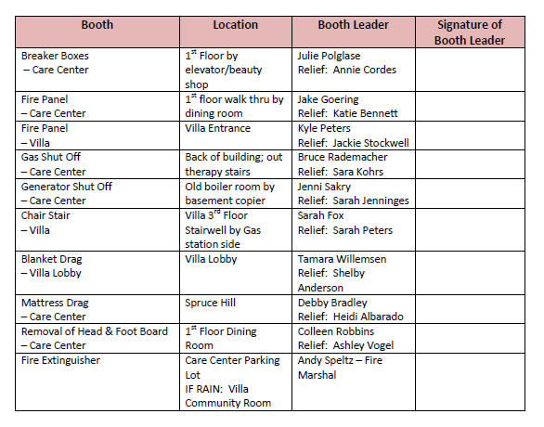
Other Booths
Notes:
Gas Shut Off; Generator Shut off, Removal of Head & Foot Boards.

Slide 14
Strengths from Outside Partners
This exercise functioned very well. The staff observed appeared to have good working knowledge of the emergency plan and procedures. There was very good leadership and decision making. The plan is well laid out and complete. Staff moved the patients very efficiently and demonstrated a knowledge of the individual needs for the patients.
This evacuation was carried out in a safe manner and there were no observed life safety issues. The areas noted for improvement are small and easily correctable.
I was impressed with the level of staff engagement, and the support management showed for this exercise. All of the staff at this facility showed commitment and caring for their clients and the desire to keep them safe in the event of an emergency.

Slide 15
OFI’s
Clearly assigning Incident Command and Person in Charge for both sides.
Updating our stair chair in Villa for easier use by staff/volunteers.
Evacuation Maps to be updated on Villa and Care Center side.
Internal naming of regions within facility unclear. Update to make clearer to understand.
Labeling our Person in Charge so everyone knows who that is. (Charge Nurse, etc)
Better communication to our Incident Command. (evacuation area)
Better communication from Incident Command.

Slide 16
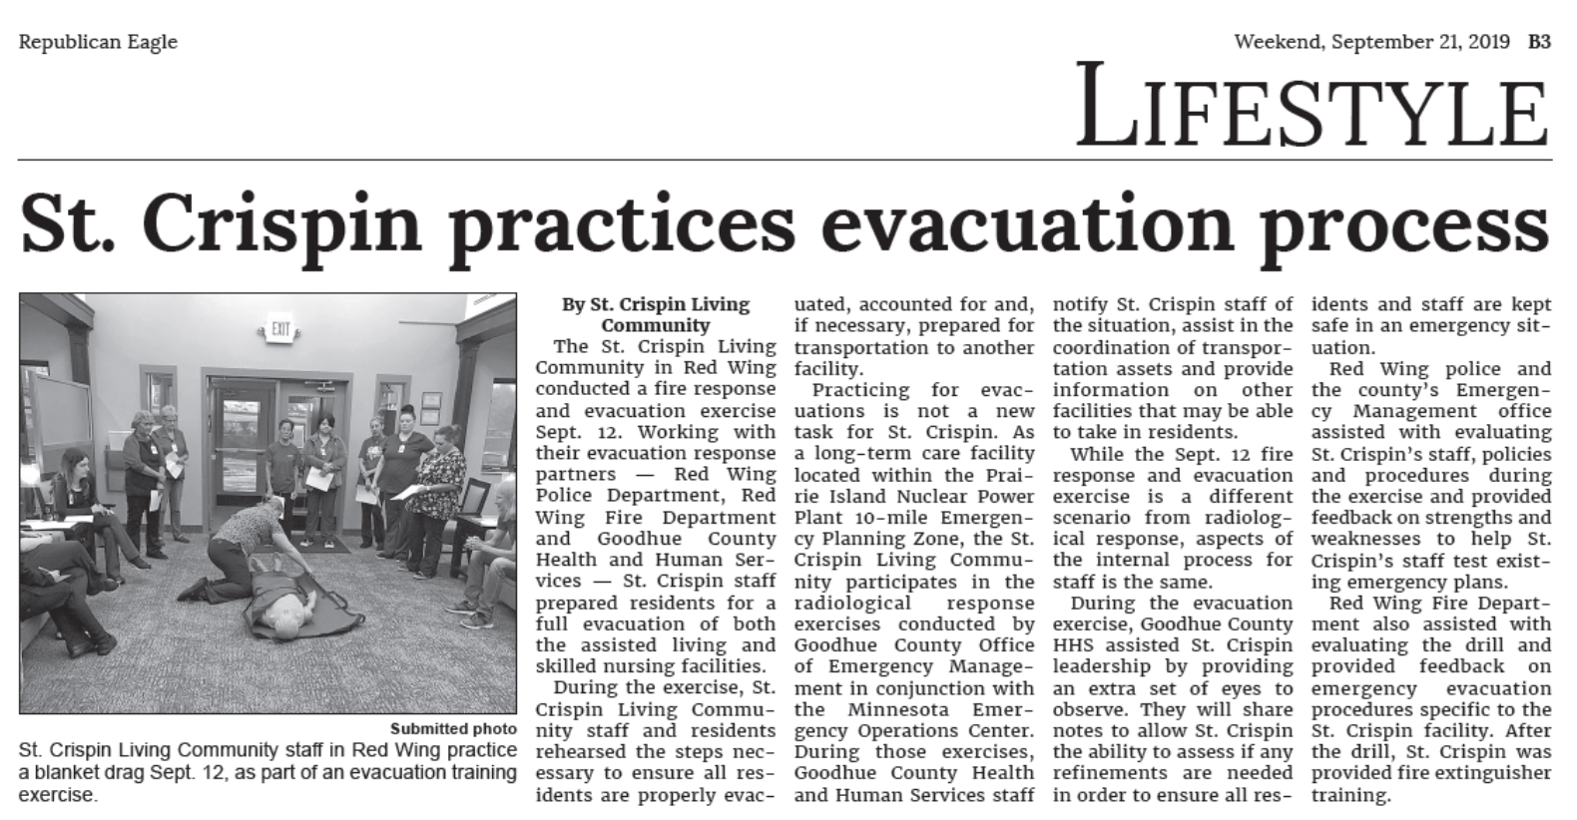
Press Release

